Slide 1
How to Create the Bridge for Staff and Student Data
Marti Mauro (Penfield CSD)
Laurie Hazard (Monroe 1 BOCES)

Slide 3
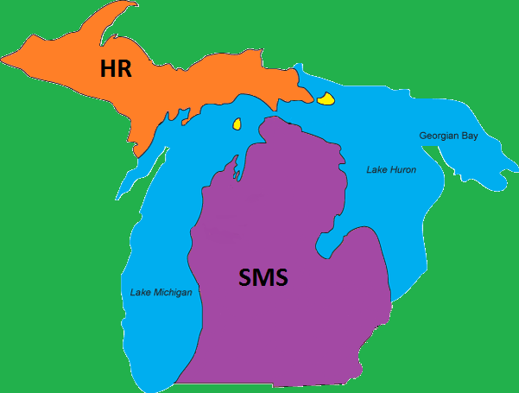
HRS
DDC

Slide 5
What Staff Data? Why? And When?
What staff data does NYSED collect? | Why? | When?
Staff Snapshot | BEDs Personal Master File (ePMF) for federal reporting Course Instructor Assignment Staff-Student-Course | Begin early October Upload at least monthly
Staff Assignment | BEDs Personal Master File (ePMF) for federal reporting (Non-Teaching Professionals only) Calculate principal State-provided growth scores under Ed Law 3012-d (Principals only) | October-February May-June (Principals only)
Staff Evaluation | Staff evaluation ratings for APPR plan under Ed Law 3012-d and eligibility for State Aid | August – Oct/Nov
Staff Tenure | Staff Tenure required under Ed Law 3012-d | June - August
Staff Attendance | Teacher attendance required by Board of Regents since 2015-16 school year in order to have complete data set | June - August

Slide 6
Why do I need to update the Staff Snapshot so often?
Staff Snapshot
Source: HR System
Source: Student Management System
Course Instructor Assignment
Staff Evaluation
Student Class Entry/Exit
Staff Assignment
Staff-Student-Course
Staff Tenure
Student Lite Template (Counselors)
Staff Attendance

Slide 7
Staff Snapshot
Staff Snapshot must be imported into Level 0 first
Defines who the staff member is
Includes information needed for BEDs PMF reporting
Demographic information
Employment related information
Includes information needed for Staff Evaluation
Also needed for Attendance and Tenure data
Links to templates from SMS

Slide 8
Who is included in Staff Snapshot?
Teaching Staff
Non-Teaching Professional Staff
Include teachers that should be reported for APPR and PMF purposes
Include only long-term subs who are serving as the Teacher of Record for courses
Do NOT include teacher aides or assistants
Principals
Refer to non-teaching assignment codes in SIRS manual and posted here: http://www.p12.nysed.gov/irs/beds/PMF/home.html

Slide 10
Bridging the gap throughout the year
HRS
DDC
Fall

Slide 11
What needs reporting?
From HR system
Staff Evaluation
Staff Snapshot – for BEDS ePMF forms
Staff assignment – for BEDS ePMF forms non-teaching assignments
From SMS system
Course Instructor Assignment
Student Class Entry/Exit
HRS
DDC

Slide 12
Staff Evaluation
HRS
Who? Districts, BOCES, and charter schools with approved APPR plans
What? 2017-2018 teacher & principal evaluation Original and Transition scores and ratings based on APPR plan
Where? HR data system or other 3rd party system
When?
Data is due November 16
Certification is due November 30
How????

Slide 13
Who needs what? Original and Transition Scores
HRS
Original scores and ratings only
The required student performance subcomponent is not based, in whole or in part, on the NYS grades 3-8 ELA or math assessments or on a State-provided growth score
Both original and transition scores and ratings needed
The required student performance subcomponent is based, in whole or in part, on the NYS grades 3-8 ELA or math assessments or on a State-provided growth score
Both original and transition scores and ratings needed, State-provided growth score not received
The required student performance subcomponent is based, in whole or in part, on a State-provided growth score, but the State-provided growth score was not received (e.g., due to low participation rates, data issues, etc.)
*If your district is using optional subcomponents, be sure to read APPR Summaries for Data Submission: Information and Examples found at https://www.engageny.org/resource/appr-3012-d

Slide 14
Your District’s APPR Summary
HRS
Posted on IRS Business Portal: https://portal.nysed.gov/
Describes which educators need
Original Scores ONLY
Original AND Transition Scores
Whether or not the optional components are used
Who should have a State-provided Growth score (SPG)
Who has an SLO based on a NYS grades 3-8 ELA or math assessment
Who needs an Alternate SLO score

Slide 15
APPR Summary Example

Slide 16
Getting the Data: One District’s Process
HRS
1. Prior Year Staff Evaluations (APPR):
Pull Growth Scores / Ratings file
Scrub unnecessary data
Keep Points and Ratings
Be sure all teachers are in the list
Goes to HR to update

Slide 17
Reporting Original Scores
HRS

Slide 18
Reporting Transition Scores
HRS

Slide 19
HRS

Slide 20
Student Performance Rating
HRS

Slide 21
Teacher Observation/Principal School Visit Ratings
HRS

Slide 22
HR Preparation One District’s Process
HRS
Pull all together into spreadsheet:
SLO’s come from the Principals
ASI provides District-wide SLO: K-2 & Special Area teachers
Transition Scores – for those who need transition
Observation scores
Upload into the database used for Observations (OASIS)
Provides notification to teachers
Upload into HR system (WinCap) for records and to pull totals for Data Warehouse

Slide 23
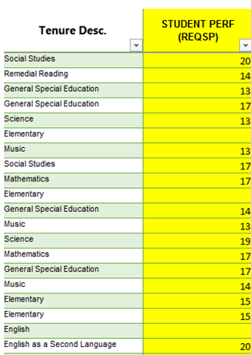
SPREADSHEET TO MATCH AND INPUT INTO MLP: NYS SCORES/TEACHER EVALS w/HEDI
HRS

Slide 24
UPLOAD (IMPORT) INTO HR SYSTEM (WINCAP) – Then pull out for Data Warehouse ** Marti update
HRS
We are required to report student scores, teacher evaluations, transition scores and transition evaluations for appropriate tenure areas.
9 data elements out of 22 columns.
Required student performance – REQSP
Req observation
Overall Composite
Minimum of 3 rows, maximum of 5 rows for Required
Additional minimum of 3 rows, maximum of 5 rows for Transitional scores
Final Check / Verification is the Teacher – Principal, HR and ASI all check

Slide 25
What this looks like in Level 0 – no optional scores
HRS
DDC

Slide 26
Level 0 Validation Errors
HRS
http://www.p12.nysed.gov/irs/vendors/home.html
Level 0 Data Validation Rules
DDC

Slide 27
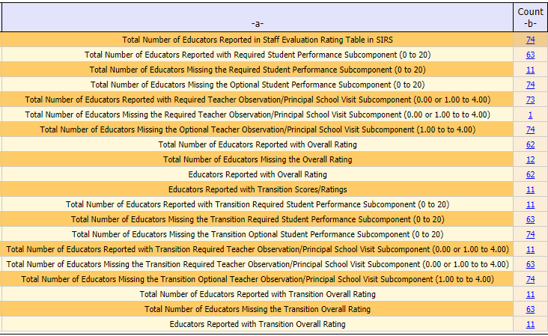
DDC’s role in Staff Evaluation
DDC
DDC’s need to get L2 report for HR to verify
SIRS-326 Staff Evaluation
Oh no! This teacher should not have transition scores!
Data points accidentally reported - need to request a purge for data
Contact your RIC
Scrutinize the zeroes!
Do not report zeroes unless person earned a zero

Slide 28
Staff Evaluation Resources
HRS
Engage NY website
https://www.engageny.org/resource/appr-3012-d
Resources for Closeout of 2017-18 APPR
Downloadable Resources
Growth Score Data File Layouts
http://www.p12.nysed.gov/irs/beds/PMF/home.html
Contact NYSED with your questions
educatoreval@nysed.gov
Contact your RIC for help with reporting your data

Slide 29
BEDs ePMF Data Collection
HRS
Who? Districts, BOCES, and charter schools
What? Personnel Master File data for all teachers and non-teaching professionals for federal BEDs reporting
Where? HR data system, TAA system, & SMS
When?
Collection opened October 3
Deadline for teachers to complete ePMF form in TAA December 14
Certification due February 1
Course Instructor Assignment & Student Class Entry/Exit data due February 1

Slide 30
Overview of ePMF Process
HRS
The Staff Snapshot must be loaded before first!
TEACH ID is a key field
Remember: Use district email
Make sure Teachers have TEACHER in Teacher Title field (8)
Load Staff Assignment
Principals and non-teaching professionals
Once Staff Snapshot is pushed to Level 2, staff will be able to access their ePMF forms in TAA (Teacher Access and Authorization)
New teachers will be sent an email token in order to create new accounts in TAA
Teachers add teaching assignment to ePMF form in TAA and submit it
Non-teaching professionals can review their forms in TAA but cannot edit (optional)
Admins review forms and certify ePMF data in TAA

Slide 31
Staff Snapshot Snafus
HRS
2. Current Year Staff Snapshot:
Years for teaching in / out of district
Professional Development indicator
Any position changes
Continue to update throughout the year
New people - work email address
Itinerant Staff

Slide 32
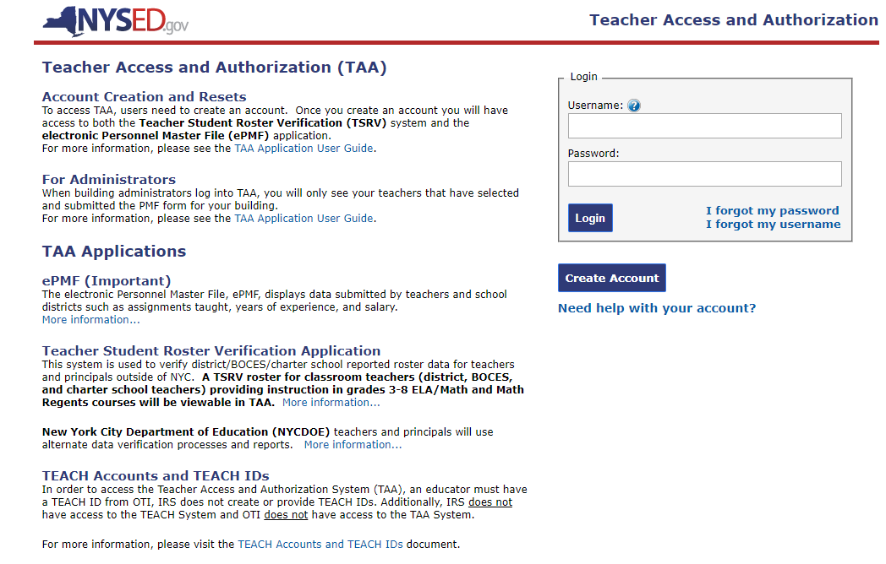
What is TAA?
HRS
Teacher Access and Authorization system
ePMF
Teacher Student Roster Verification
Types of Accounts
TAA Administration
Administrator View
Review and manage data
Certify data
Username: SEDDAS account
TAA Users
Teachers and non-teaching professionals
Teachers add teaching assignments
Username: work email
TAA User Guide: http://www.p12.nysed.gov/irs/beds/PMF/documents/TAAAdministrationApplicationUserGuide.pdf
Provide snapshot of how to enter assignments
Refer to assignment codes on NYSED site

Slide 33
TAA Users – teachers and non-teaching professionals
HRS
If Staff Snapshot is loaded, users will see data prepopulated in their ePMF file.
Teachers need to add Location and Assignments
Non-teaching professionals can review their assignments

Slide 34
How to add teaching assignments
HRS

Slide 35
Guidance Documents for Teachers
HRS
Teacher/Staff Data Landing Page:
http://www.p12.nysed.gov/irs/beds/PMF/home.html

Slide 36
TAA for Administrators
HRS
TAA/TSRV role
View account creation
Reset TAA accounts
View submission status of ePMF
TAA/TSRV/ePMF role
View account creation
Reset TAA accounts
View submission status of ePMF
Edit ePMF data for staff they oversee

Slide 37
Submitted ePMF data
HRS

Slide 38
Staff Assignment for BEDS PMF Reporting
HRS
Assignment data for Non-Teaching Professionals for ePMF BEDs purposes
Assignment data for Principals to calculate State-provided growth scores
Staff ID = TEACH ID
Assignment Grade Level – use ALL or individual records for each grade (do not use 13 or 14)

Slide 39
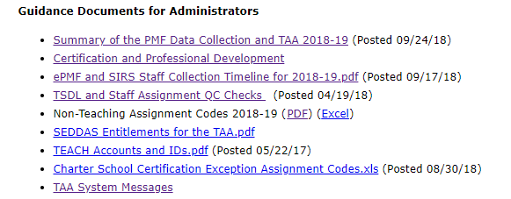
Guidance Documents for Administrators
HRS
Chapter in 18-19 SIRS Manual:
http://www.p12.nysed.gov/irs/sirs/
Teacher/Staff Data Landing Page:
http://www.p12.nysed.gov/irs/beds/PMF/home.html

Slide 40
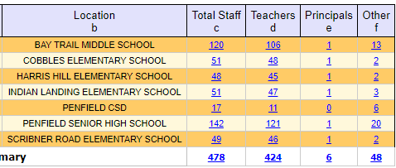
DDC’s role in BEDS ePMF
DDC
DDC’s need to get L2 report for HR to verify
SIRS-320 Staff Snapshot
SIRS-318 Staff Assignment

Slide 41
Course Instructor Assignment & Student Class Entry Exit
DDC
Will replace ePMF collection in TAA for teacher assignment data in near future
Data comes from SMS
Course Instructor Assignment
What the teacher is teaching
Student Class Entry/Exit
Who the teacher is teaching
Due in February 1

Slide 42
Course Instructor Assignment
DDC
There will be at least one Course Instructor Assignment record attached to each course
Each course must have a Primary Teacher (Teacher of Record)
Each teacher for a course, will have a Course Instructor Assignment record for that course

Slide 43
Student Class Entry/Exit
DDC
Students will have a Student Class Entry/Exit for each course they have been enrolled in during the course of the year
Identifies the dates the student started and ended in the course
Contains the Dual/Concurrent Credit Indicator show whether the student is enrolled in a course in an attempt to earn both high school and post-secondary credit
Must have Course Instructor Assignment records in L0 before you import Student Class Entry/Exit records

Slide 44
Course Instructor Assignment: What can go wrong?
DDC

Slide 45
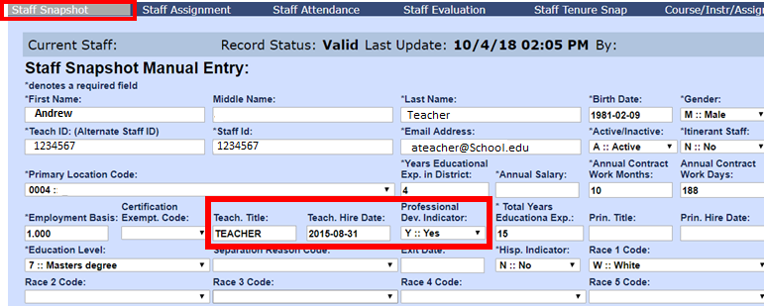
Course Instructor Assignment
DDC

Slide 46
Student Class Entry/Exit
DDC

Slide 47
Class Entry Exit
DDC
Back to the Staff Snapshot

Slide 48
Link with SMS
DDC
TEACH ID – both systems link with this data element
Course Instructor Assignment
Student Class entry/exit
Staff-student-course
Creating a ongoing schedule for upload staff snapshot – at least once a month

Slide 49
Bridging the gap throughout the year
HRS
DDC
Spring

Slide 50
Teacher Student Data Linkage
DDC
Staff Assignment
Principals ONLY
Staff-Student-Course
Staff Snapshot must be current
HRS

Slide 51
Staff Attendance
HRS
Be sure to take a look at staff attendance before everyone leaves for the summer!

Slide 52
Bridging the gap throughout the year
HRS
DDC
Summer

Slide 53
Staff Tenure
HRS
Based on hire date
Start digging in during June

Slide 54
Staff Attendance
HRS
Starting digging in after last teacher day
January and June to verify

Slide 55
Questions ??

